Slide 1

Decoding Music Trends on Spotify
Yiming Tian
Fall 2024
Information Visualization Final Project

Slide 2
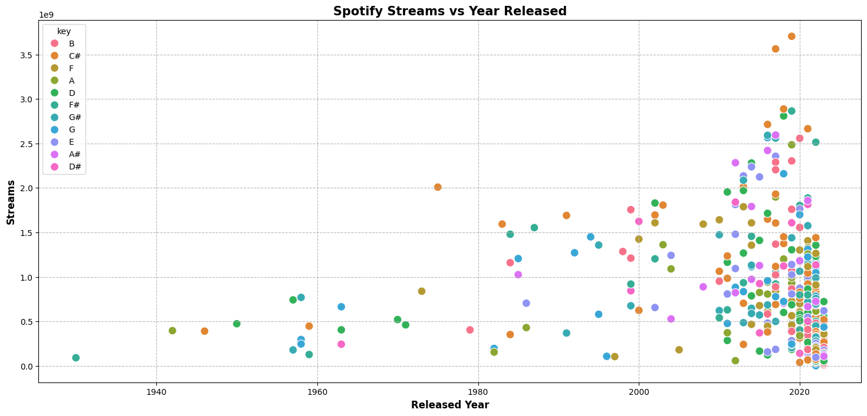
Visualizations
Scatter Plot
Releases are mostly around 2020
Most popular key is C#
Significant increase streams for songs released after 2015

Slide 3
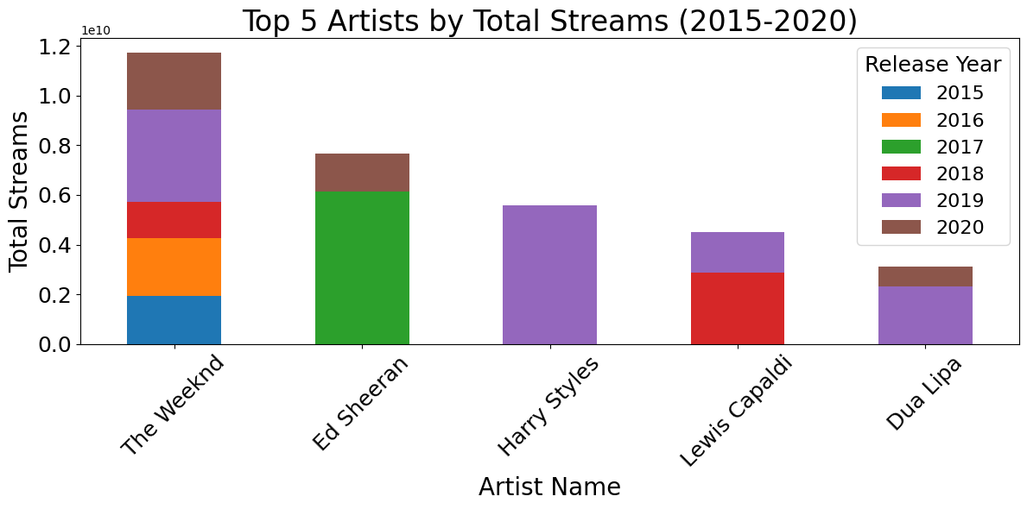
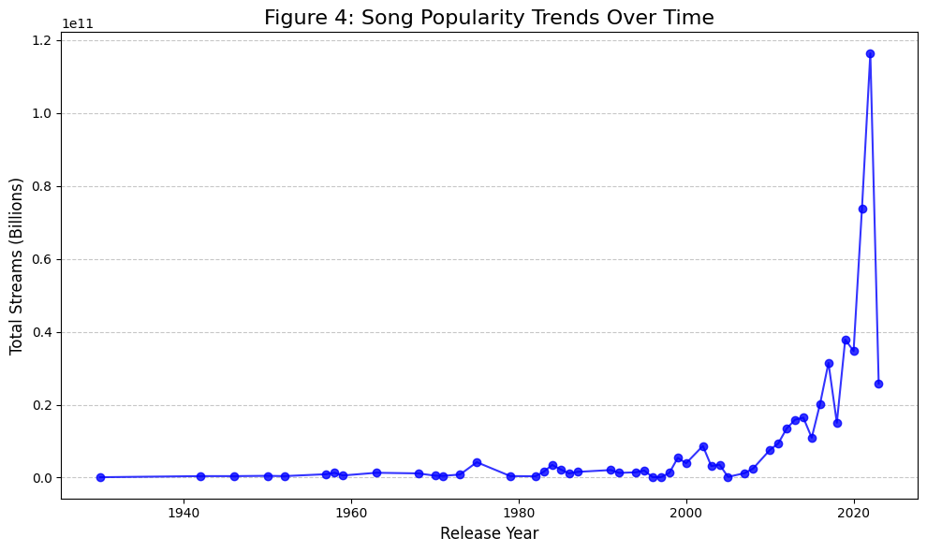
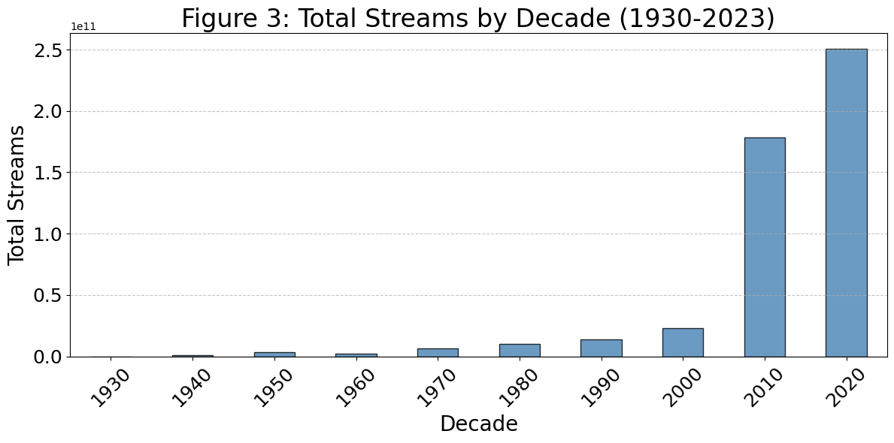
Popularity Analysis
Barchart, Line Charts
Top Artists: The Weeknd, Ed Sheeran, Harry Styles, Lewis Capaldi, and Dua Lipa dominated 2015-2020.
Streaming Boom Around 2000: A significant increase in streaming occurred around the year 2000.
2020s Streaming Spike: Streaming experienced a massive surge in the 2020s.

Slide 4
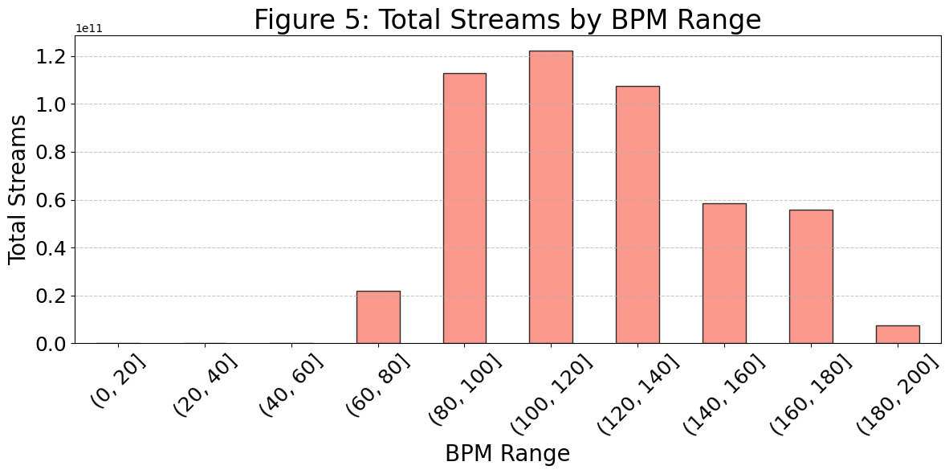
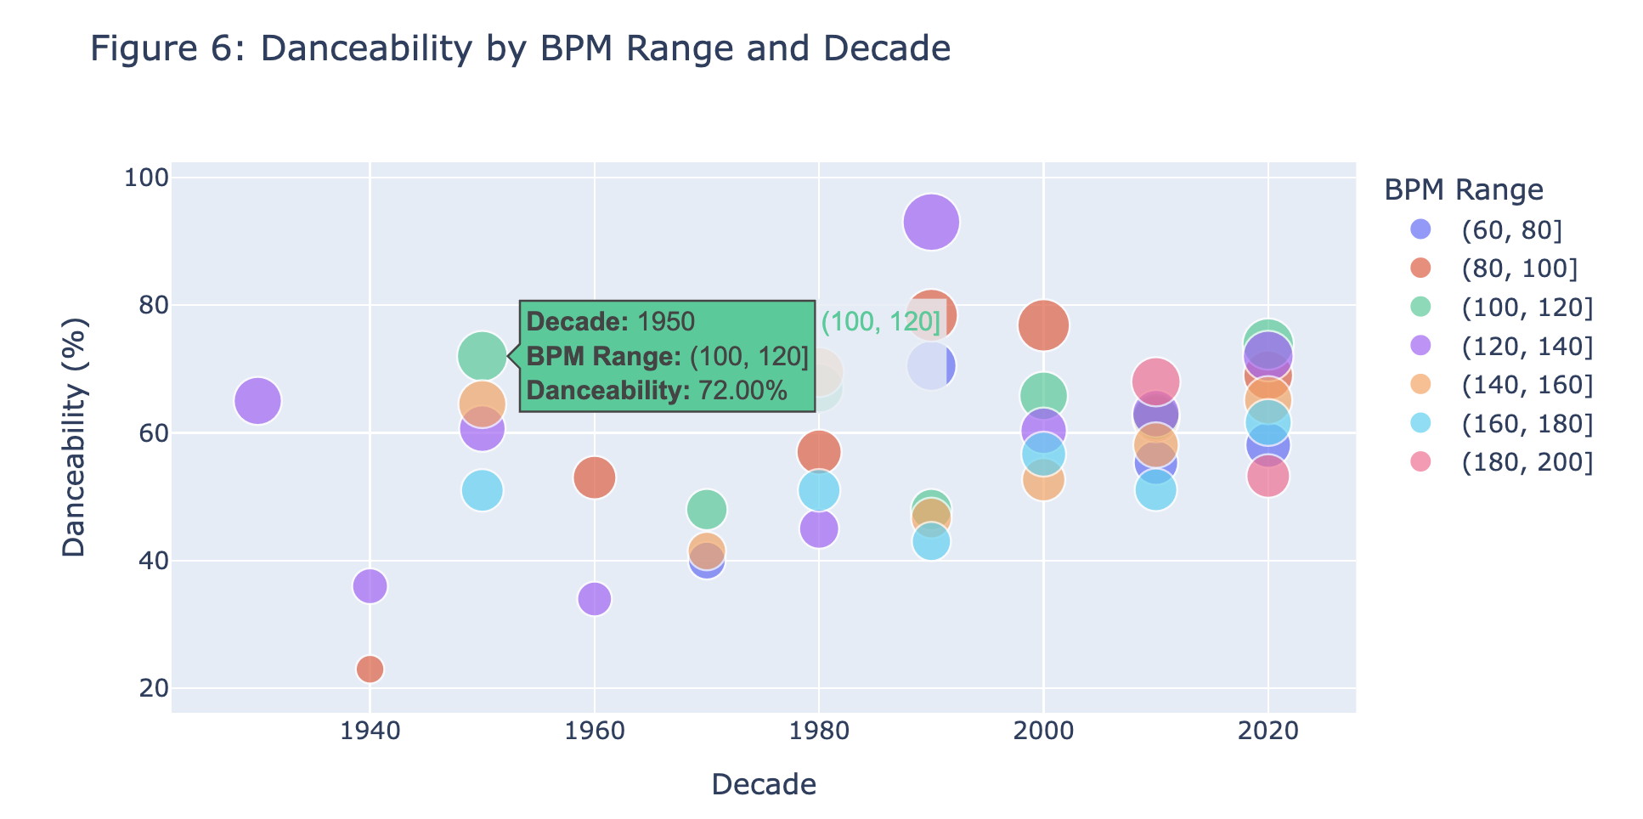
BPM Analysis
Bar Chart, Interactive Scatter Plot
Mid-tempo wins: 100-140 BPM songs are most streamed.
Danceability peaks at 100-120 BPM.
Modern music is more danceable across tempos.

Slide 5
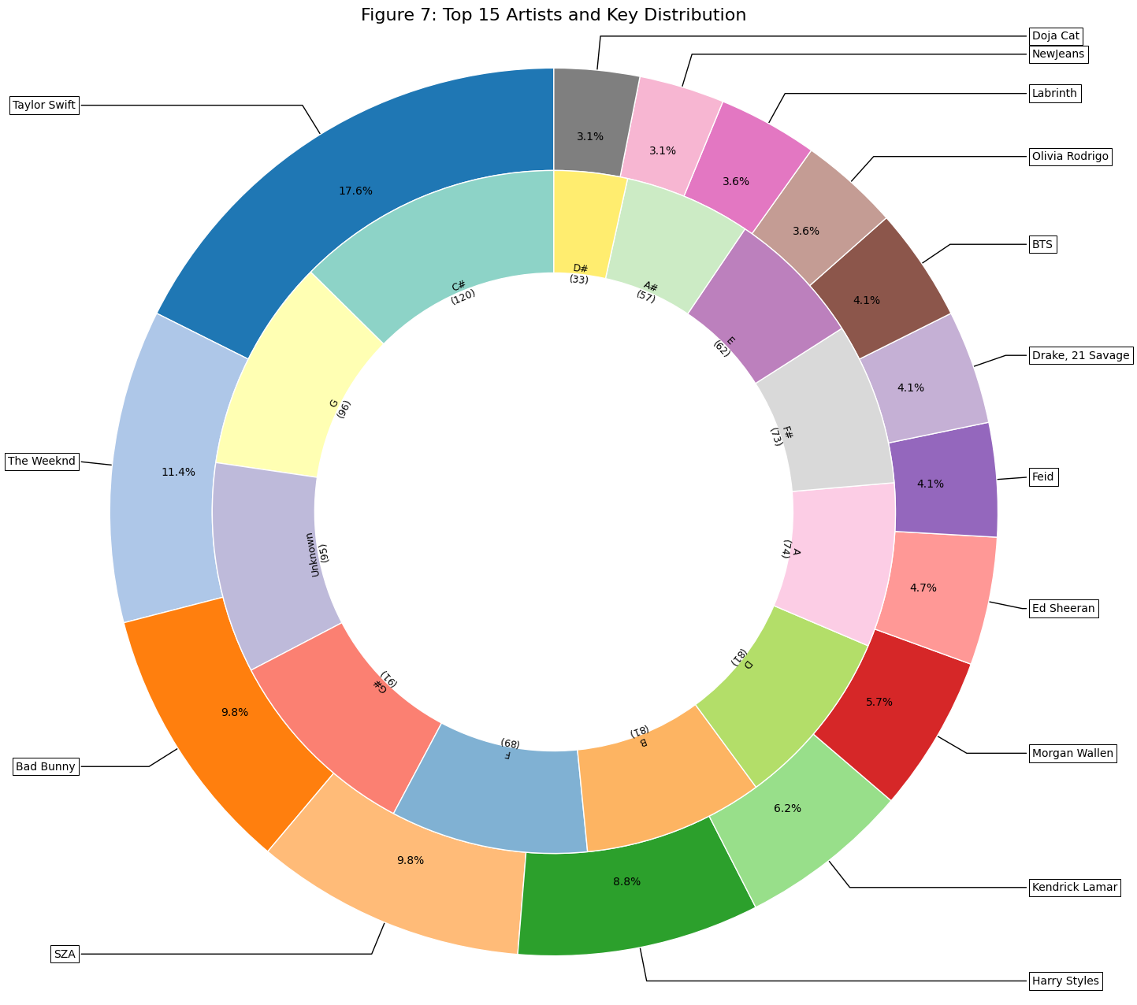
Top Artists and Keys analysis
Donut Chart/ Pie Chart
Top Artists: Taylor Swift & SZA
Most Frequent Key: C#
Diverse range of artists and keys for popular streams

Slide 6
Work Cited
Data:
https://www.kaggle.com/datasets/abdulszz/spotify-most-streamed-songs
Spotify Logo:
https://www.logo.wine/logo/Spotify

